Slide 1
OpenAI Gym
2017 / 12 / 27

Slide 2
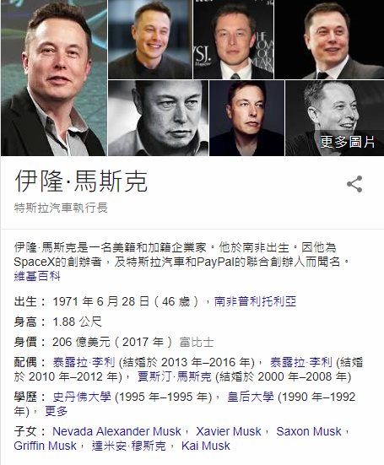
OpenAI Gym
Elon Musk
Provides environments for RL.
RL stands for Reinforcement Learning.

Slide 3
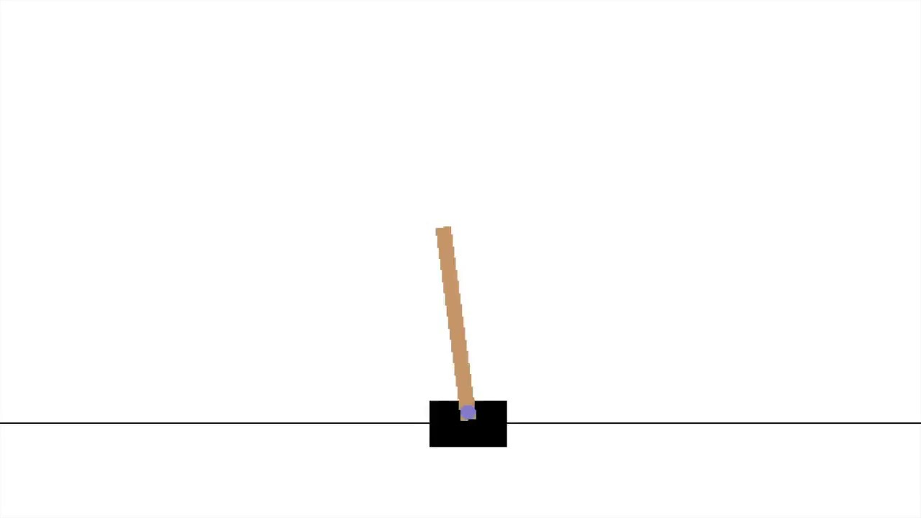

Slide 4
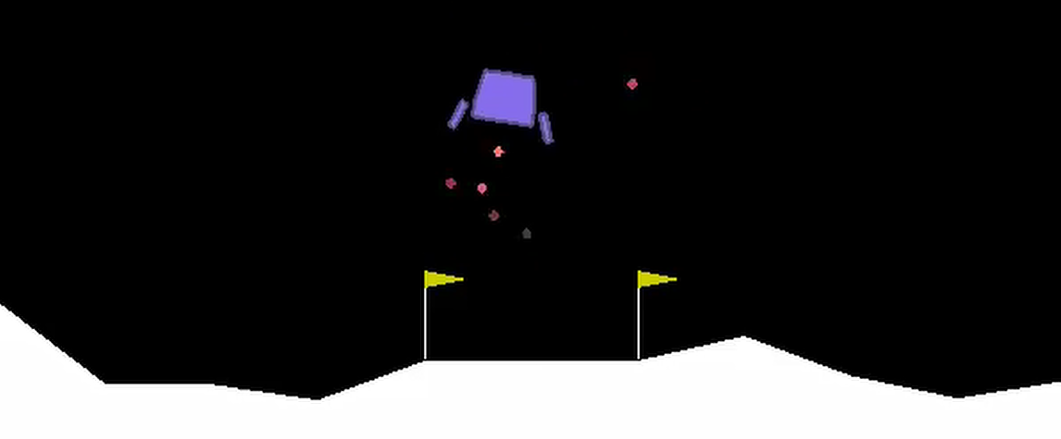

Slide 5
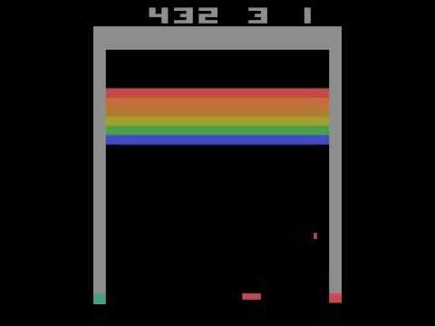

Slide 6
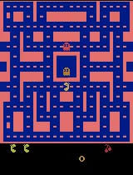

Slide 7
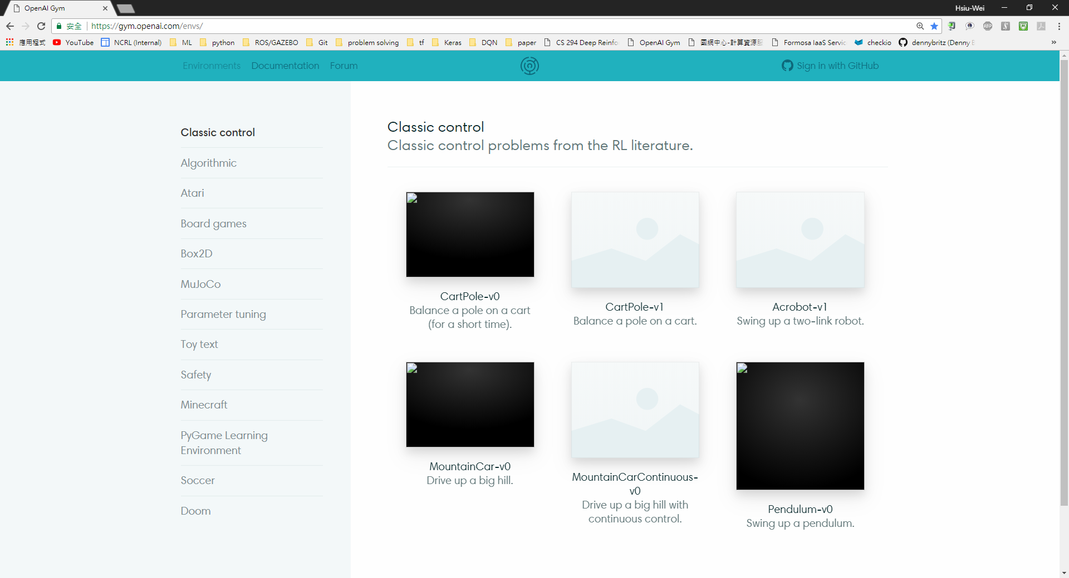
https://gym.openai.com/envs

Slide 8
Clone code
git clone https://github.com/showaykerker/gym_tut_NCRL
cd gym_tut_NCRL
gedit run.py

Slide 9
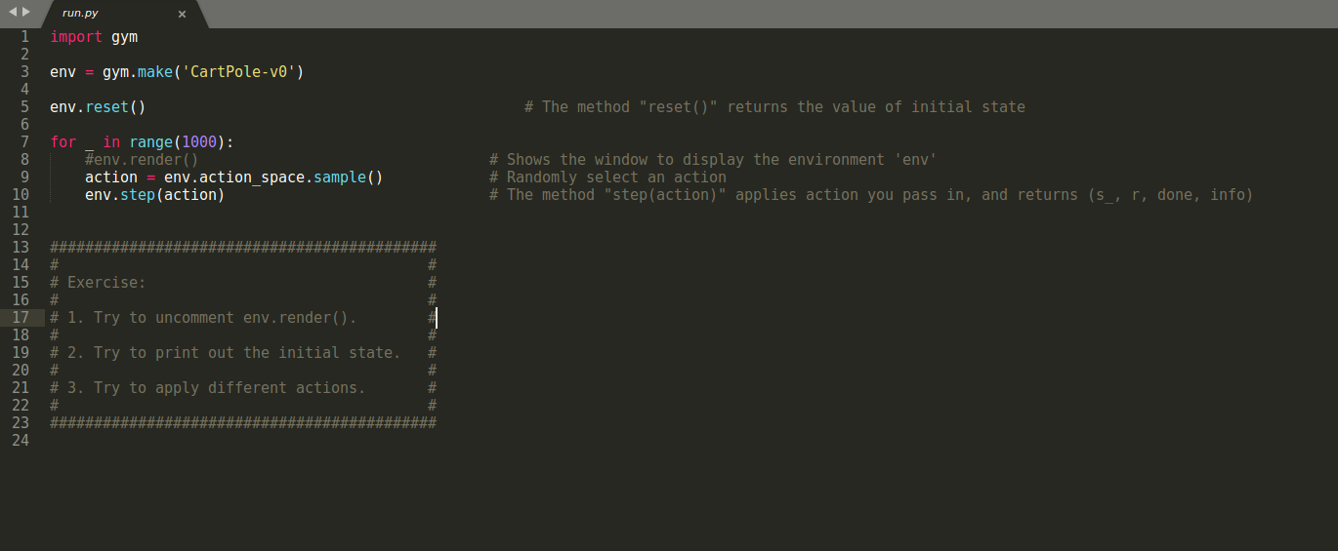

Slide 10
API ( 應用程式介面、应用程序接口 )
An application programming interface (API) is a set of subroutine definitions, protocols, and tools for building application software.

Slide 11
OpenAI Gym API
env = gym.make(‘ENVIRONMENT’)
env.reset()
env.render()
env.step(action)

Slide 12
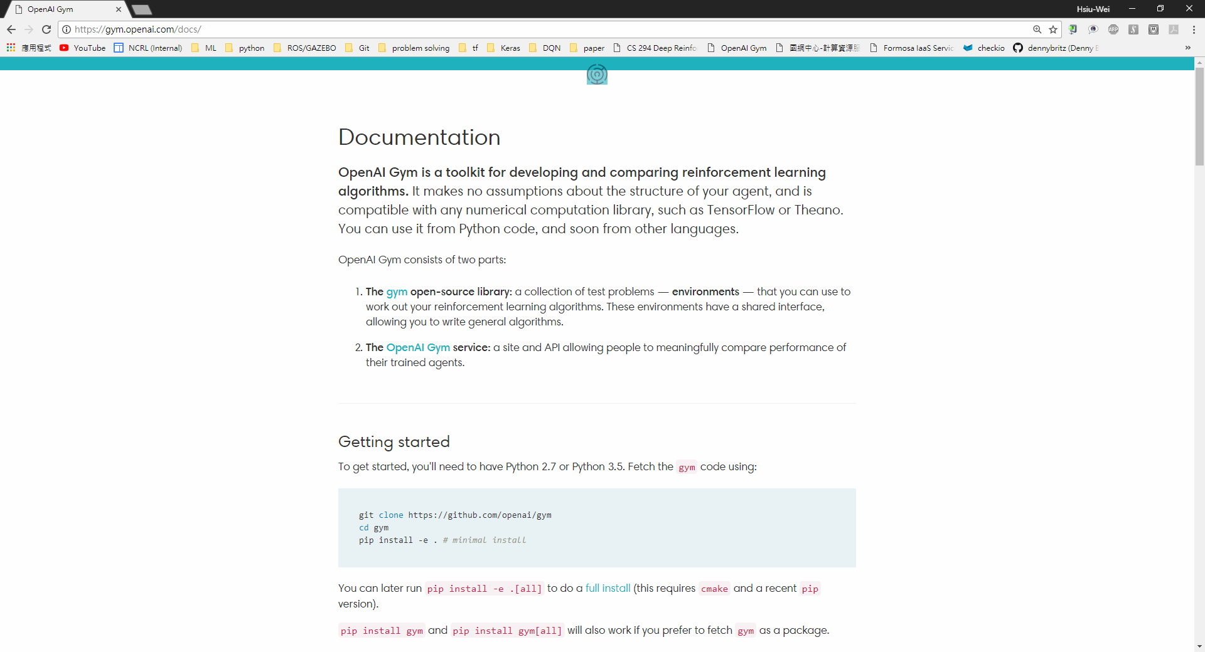
https://gym.openai.com/docs

Slide 13
OpenAI Gym API (II)
env.action_space
env.observation_space
env.observation_space.high
env.observation_space.low

Slide 14
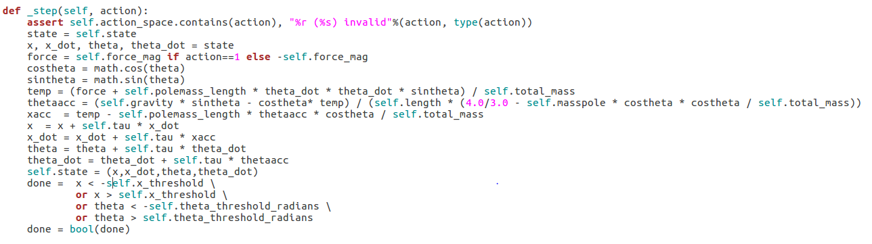
Find Out What Observations Indicate
Mostly put in gym/gym/envs/[ENV] under “_step()”
For example: ~/gym/gym/envs/classic_control/CartPole.py

Slide 15
Car_env
gym_tut_NCRL/2D_car/car_env.py
gym-like:
reset()、step(a)、render()

Slide 16
Run
python3 main.py

Slide 17
In Case You Forget How To Do It…

Slide 18
Build Model
model = Sequential()
model.add(Dense(units=1, input_dim=1))
model.compile(loss=‘mse’, optimizer=‘sgd’)

Slide 19
Neural Network
… …
…
…
…
INPUTS
( Input Layer )
OUTPUTS
( Output Layer )
( Hidden Layers )

Slide 20
Build Model
model = Sequential()
model.add(Dense(units=1, input_dim=1))
model.compile(loss=‘mse’, optimizer=‘sgd’)
model = Sequential([
Dense(units=1, input_dim=1)
])
model.compile(loss=‘mse’, optimizer=‘sgd’)

Slide 21
Build Model
model = Sequential()
model.add(Dense(units=64, input_dim=1, activation=‘relu’))
model.add(Dense(64, activation=‘tanh’))
model.add(Dense(1))
From keras.layers import Dense, Activation
model=Sequential([
Dense(units=64, input_dim=1),
Activation(‘relu’),
Dense(64),
Activation(‘tanh’),
Dense(units=1)
])

Slide 22
Train Model
# Data D has 50000 (X, Y) data.
# X_train, Y_train = X[:40000], Y[:40000]
# X_test, Y_test = X[40000:], Y[40000:]
for i in range(TRAINNING_ITER):
cost = model.train_on_batch(X_train, Y_train)
# model.compile(loss=‘mse’, optimizer=‘sgd’)
model.fit(X_train, Y_train, epochs=128, steps_per_epoch=64)

Slide 23
Test Model
cost = model.evaluate(X_test, Y_test, batch_size=128)
cost = model.test_on_batch(X_test, Y_test)

Slide 24
Predict
# X_test, Y_test = X[40000:], Y[40000:]
Y_predict = model.predict(X_test)

Slide 25

THANKS!
Any questions?

